Slide 1

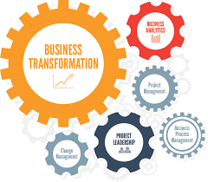

DELIVER
Business Change and Transformation

Slide 2
Business Change and Transformation– Pre workshop 3
 | Pre-workshop study | Programme Objectives
 | Achieving Excellence | A refresher on lean management techniques in delivering service improvement projects
 | Understanding change and the individual | Understanding the different Change Models, and why people embrace and resist change. Provides an overview of change and the learner.
Notes:
Need to check review these.

Slide 3
PART 1: ACHIEVING EXCELLENCE
To be able to achieve excellence, organisations need these key areas:
Purpose – made clear through vision and strategy
Right Leadership behaviors – managers need to be able to lead and manage effectively
Lean Thinking – this is embedding the culture of continuous improvement
These 3 areas are enabled by using different strategies, tool and techniques such as standardize way of working, great team work, problem solving from the senior level and teams and great communication channels
Check out the next slide

Slide 4
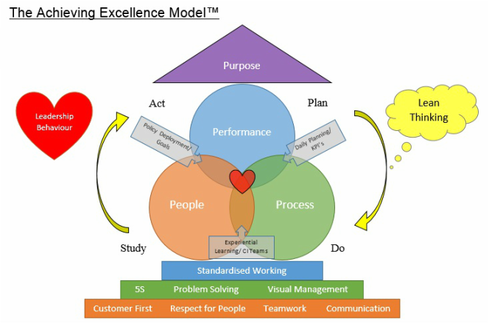

Slide 5

In the previous module we talked about leadership behaviours, this time let’s revisit ……………………….
A passionate belief that there is always a simpler, better way of doing everything
A continuous drive to identify and eliminate waste
The empowerment of employees to drive improvement
The rigorous application of lean tools and techniques
A philosophy and a management culture.

Slide 6
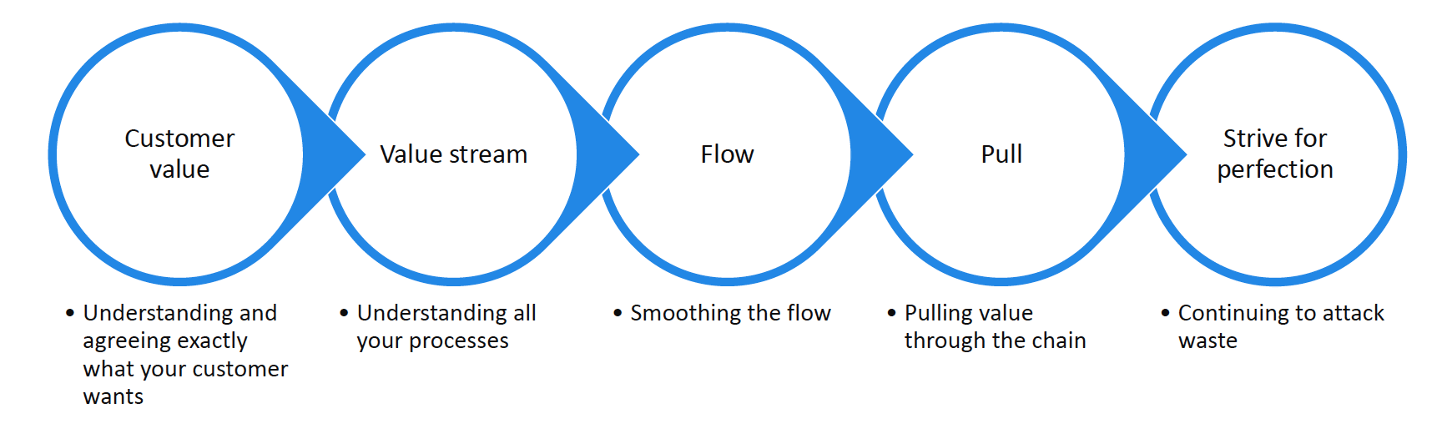
The Lean Principles

Slide 7
The Seven Service Wastes
M ovement
I nventory wrong
C ommunication is poor/wrong
R epeat
O pportunity Lost
W aiting
E rror

Slide 8
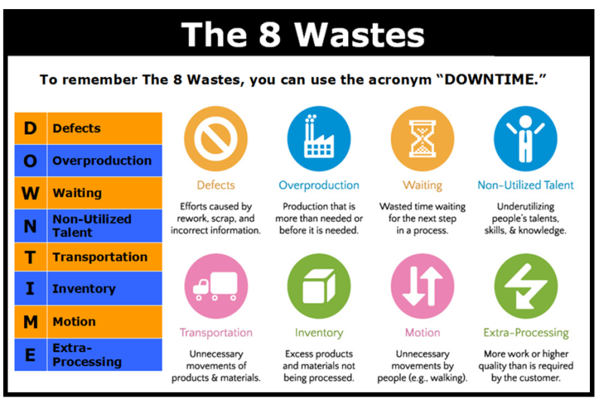

Slide 9
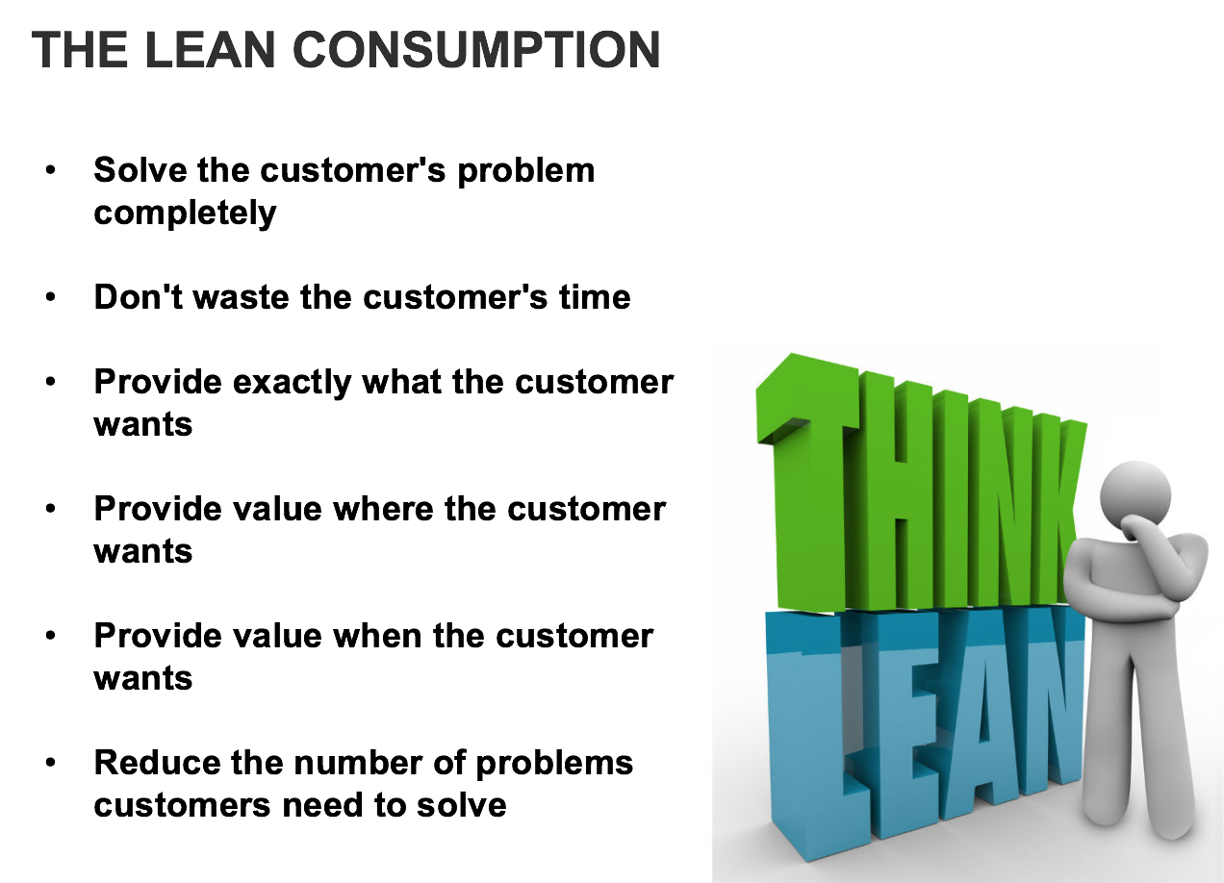

Slide 10
Value Added Activity/Non Value Added Activity
Value Added Activity
An activity that transforms material or information, for the first time, to satisfy customer needs.
In other words if the customer was to study the activity would they say ‘Yes, we’re happy to pay for this activity.
Non-Value Added Activity
Those activities that take time, resources, and/or space but do not contribute to satisfying customer needs.

Slide 11
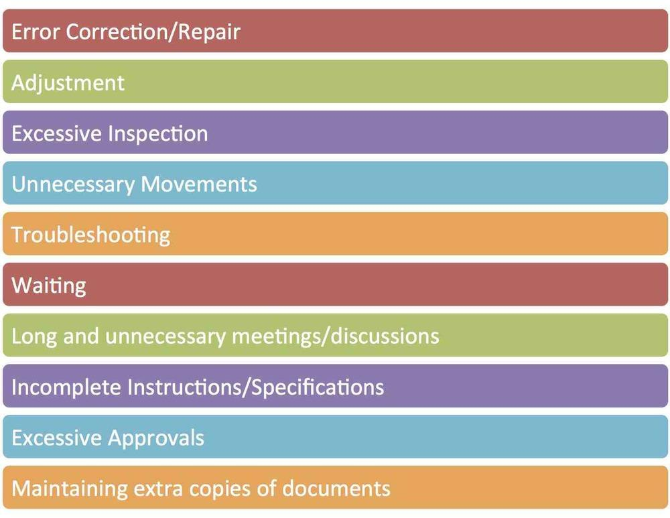
Non Value Added Activities

Slide 12
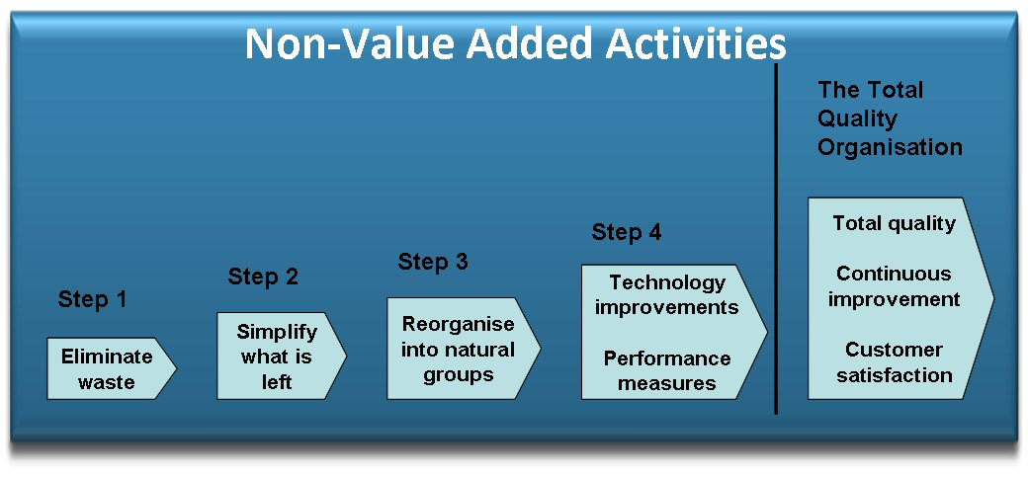
Converting Non Value Added Activities

Slide 13
TASK
In the next slides, go through the lean tools and techniques. Practice using the tools based on the examples.
Process mapping
Analytical tools – 5 whys, fishbone,
Pareto Principle
Visual management
Kaizen Workshops (no need to give example)
We will be using/discussing some of the techniques at the workshops

Slide 14
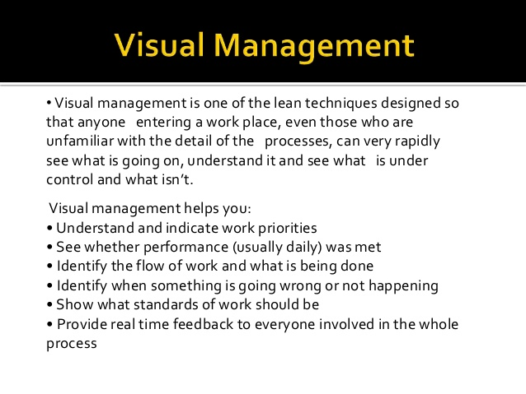

Slide 15
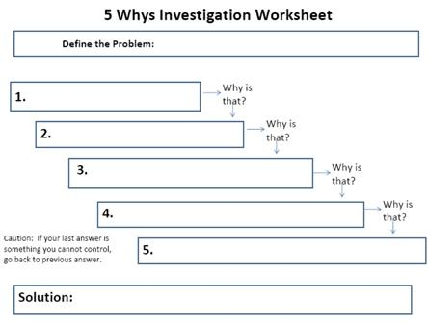
Analytical Tool – the 5 Whys

Slide 16
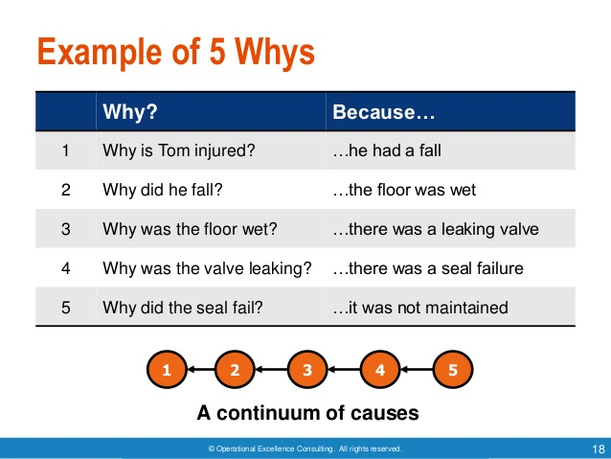

Slide 17
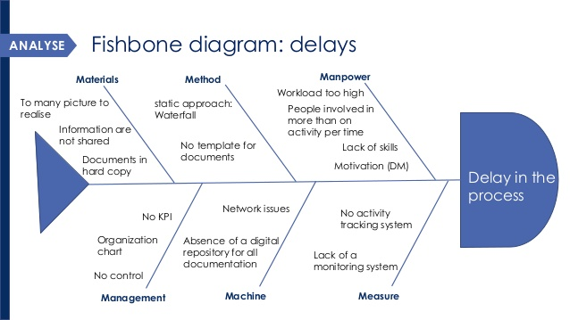
Fishbone Diagram: Cause and Effect

Slide 18
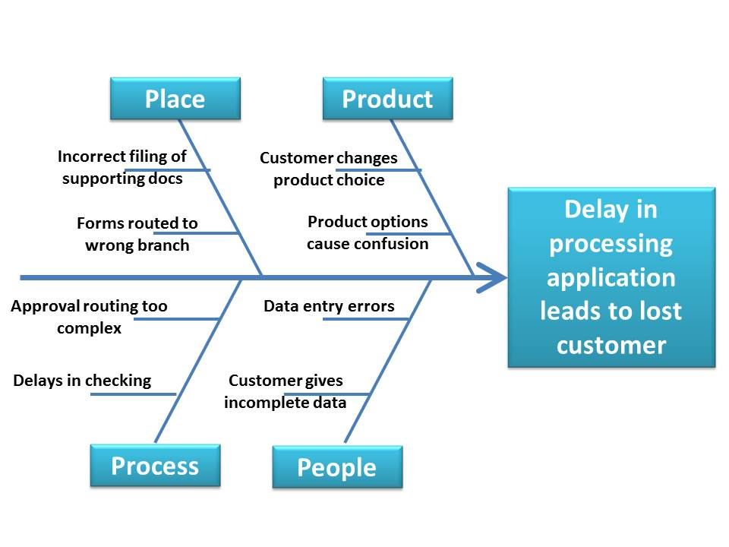
Fishbone Diagram: Another example

Slide 19
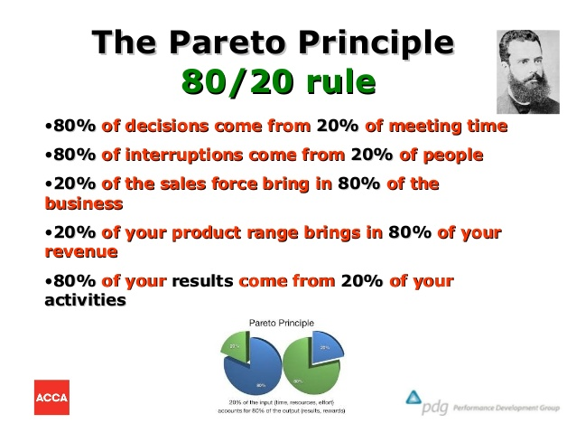

Slide 21
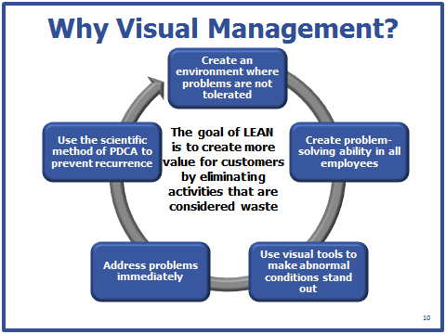

Slide 22
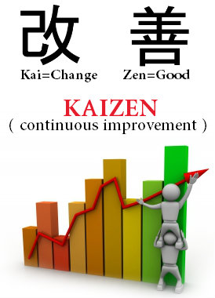
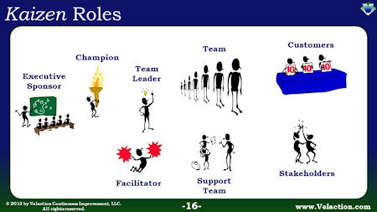

Slide 23
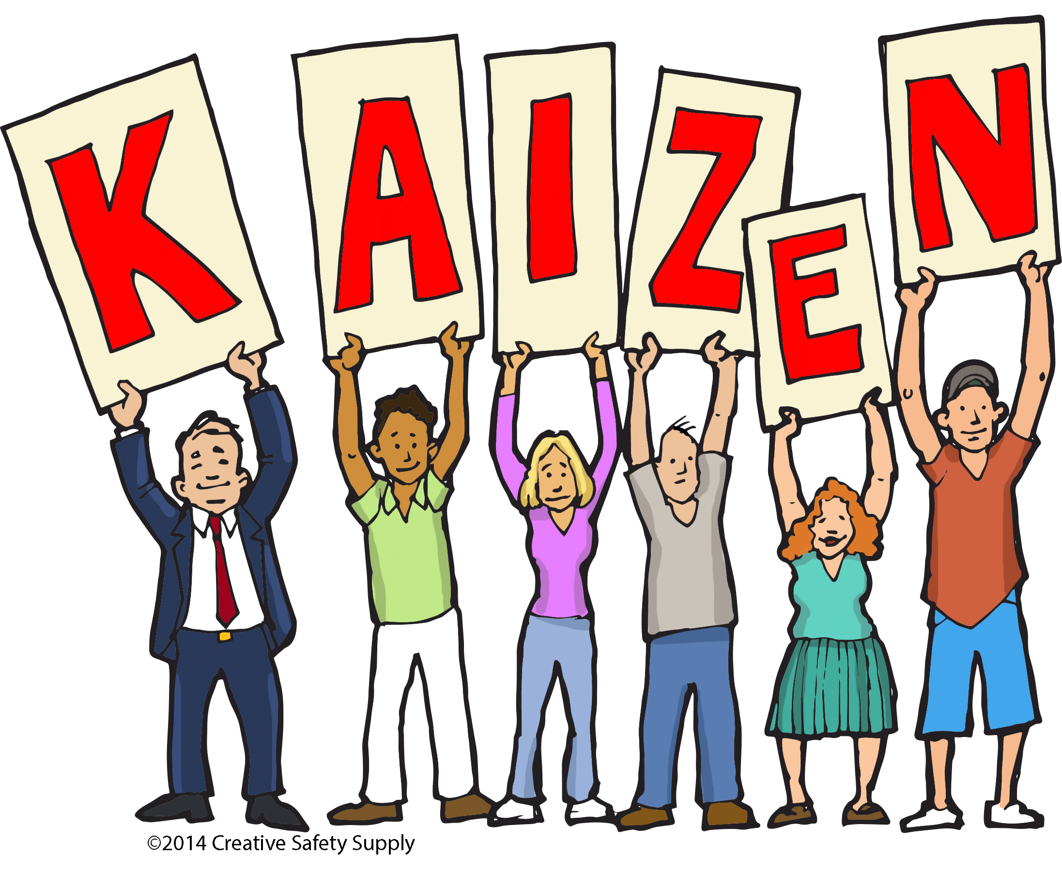
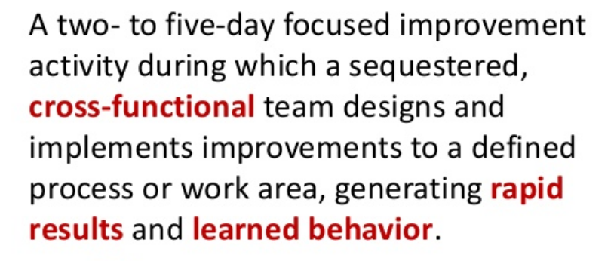

Slide 24
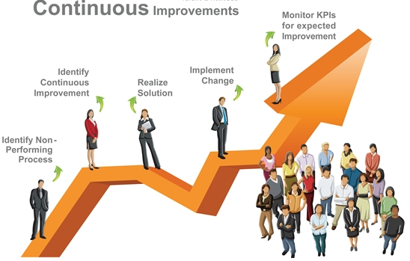

Slide 25
Task
Study the two slides reflecting a lean culture and the lean transformation framework

Slide 26
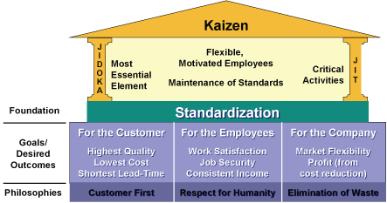
The Kaizen Culture Model

Slide 27
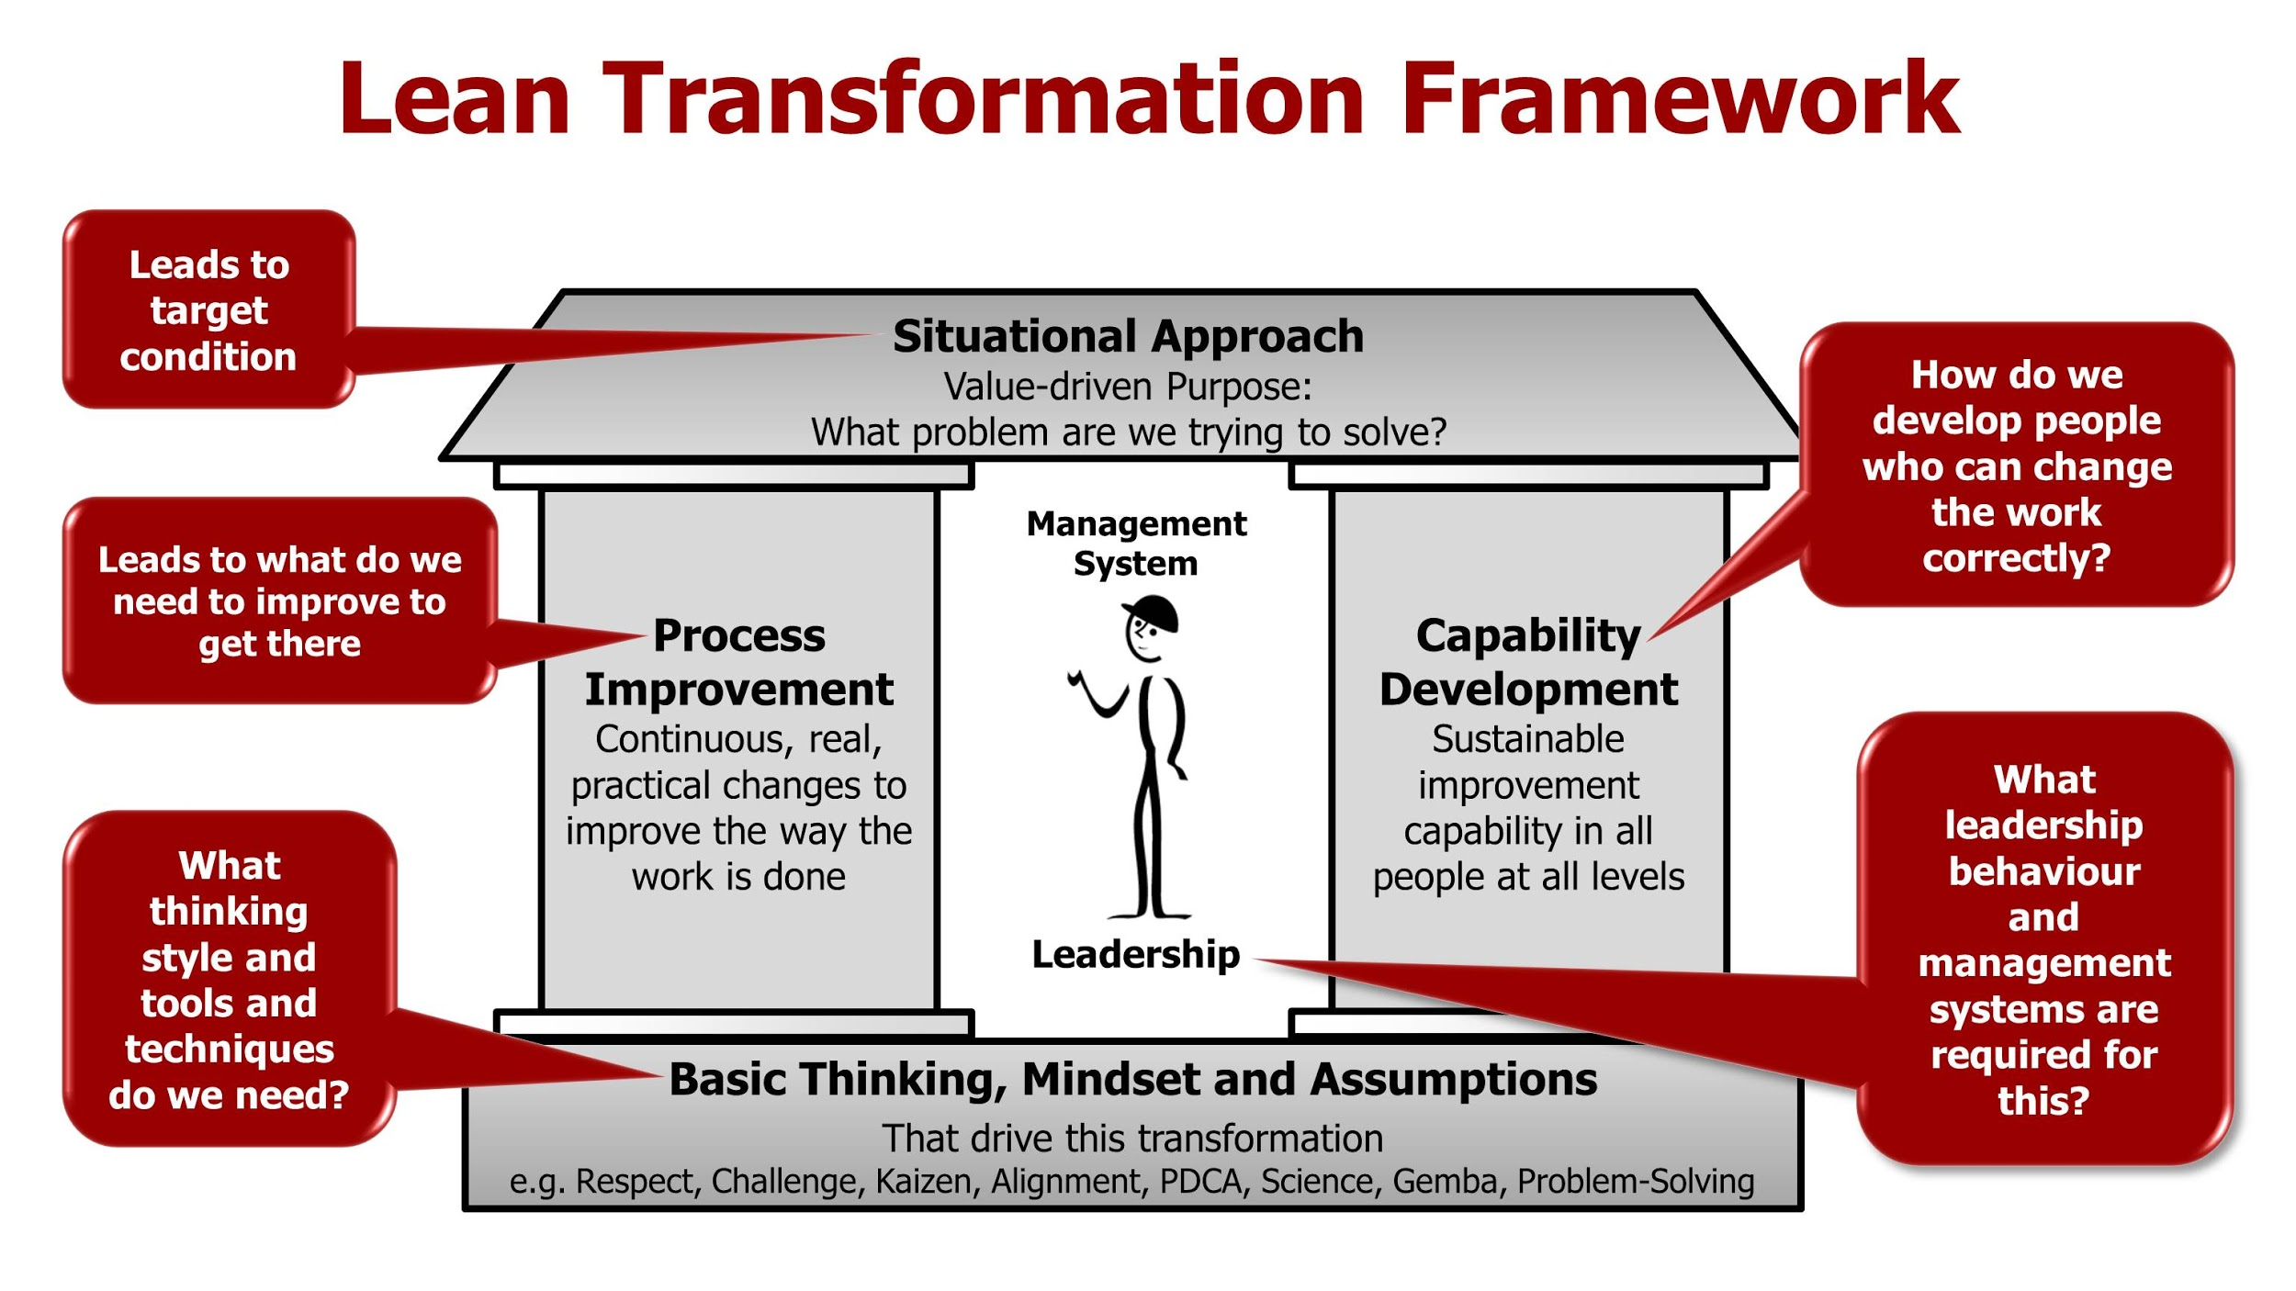

Slide 28
END OF PART 1

Slide 29
PART 2: Understanding Change and the Individual
Whether you’re the leader of a change program or part of a team that’s implementing it, understanding how change is perceived – and knowing how to support others through the transition – is a useful skill.

Slide 30
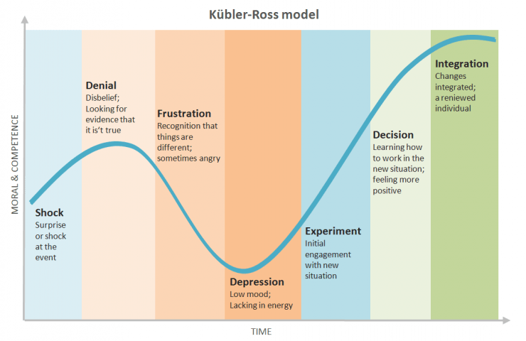
The impact of Change Curve
Watch video: https://www.youtube.com/watch?v=MWiPVW1IBVs

Slide 31
Bridges’ Transition Model
A well-known way to consider change was proposed by change consultant
William Bridges. His model, published in his 1991 book, “Managing Transitions,”
highlights three stages that people go through when they experience change.
These are:
1. Ending, losing and letting go.
2. The neutral zone.
3. The new beginning.
Bridges says that people go through each stage at their own pace. For example,
those who are comfortable with the change will likely move ahead to stage three
quickly, while others who are less comfortable will linger at stages one or two.

Slide 32
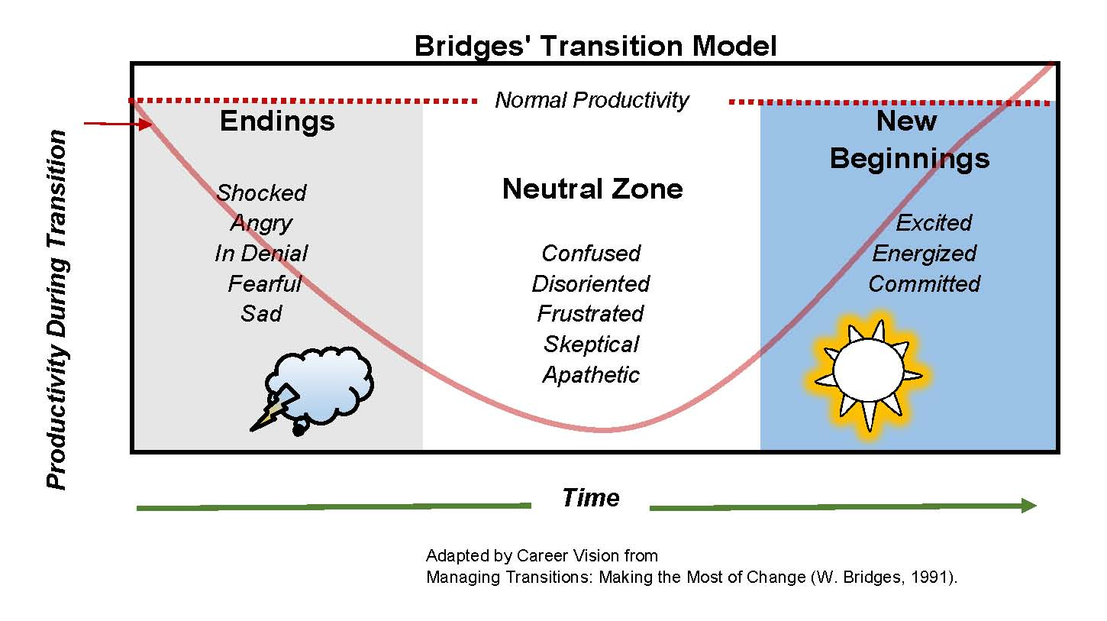
Bridges’ Transition Model

Slide 33
Bridges’ Transition Model
Stage 1: Ending, Losing and Letting Go
People enter this initial stage of transition when you first present them with change. This time is often marked by resistance and emotional upheaval, because they are being forced to let go of something that they are comfortable with.
Stage 2: The Neutral Zone
During this stage, people affected by the change are often confused, uncertain and impatient. Depending on how well you manage the situation, they may also experience a higher workload as they get used to new systems and ways of working. Think of this phase as the bridge between the old and the new. In some ways, people will still be attached to the old, while they are trying to adapt to the new.
Stage 3: The New Beginning
The last transition stage is a time of acceptance and energy. People begin to embrace the change initiative. They build the skills that they need to work successfully in the new way, and start to see early wins from their efforts.

Slide 34
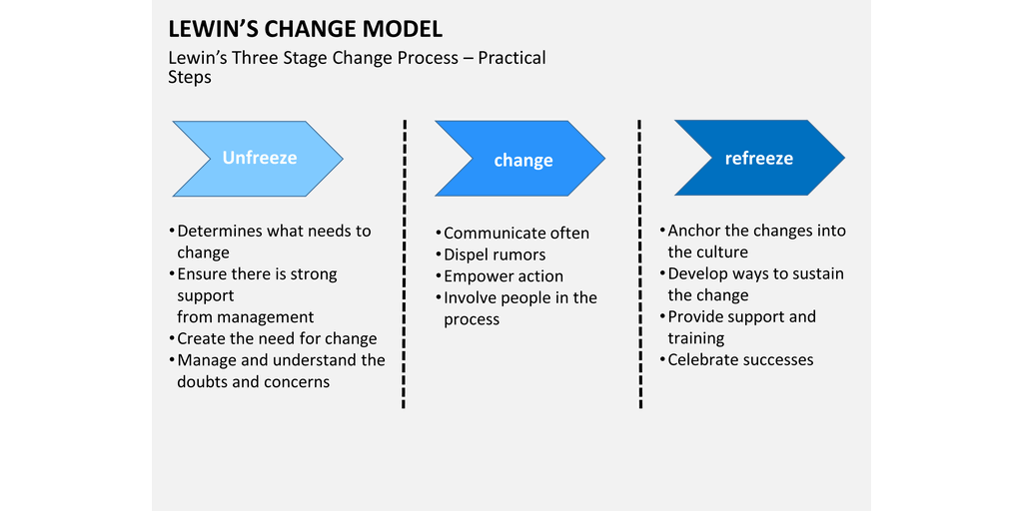
Lewin’s Change Model

Slide 35
Lewin’s Change Model
Kurt Lewin developed the “Unfreeze-Change-Refreeze” model (Lewin’s change model) in the 1950s. The Lewin’s change model describes the change in three stages and is about change in general. Nevertheless, it is widely used within companies.
To overcome resistance, people need to let go of old habits and structures. This is a difficult assignment because change leads to a disruption of a stable situation. People like to keep the old situation as it is, because it is safe and predictable. People are only capable of accepting change when they know what this change will bring them.
Lewin’s change model focuses on behaviour modification of people/ employees. The model distinguishes three stages.

Slide 36
Lewin’s Change Model
Unfreeze stage
At this stage people realize that something is going to change and they are dealing with strong emotions such as denial, impatience, uncertainty and doubt. It is essential for a business to fully disclose the state of affairs and to explain why a change process is put into force. As a result of clear communication employees are more willing to accept to the new change of direction and they can let go of old customs. During this stage, it is advisable to involve employees so that they can take a constructive approach to the change process.
Change stage
It is of crucial importance that the change is implemented within a short time. The longer the change process takes, the more employees are inclined to relapse into old habits and rituals. This stage is sometimes referred to as the “move stage” because it causes a ripple effect within an organization. By acting vigorously and implementing the change within a short time, the employees will become aware of the importance of this change more quickly.
Refreeze stage
This stage, refreeze the change, is about solidifying the change. After the change has been implemented in the change stage, employees are inclined to revert to their old habits. Therefore, it is advisable to make proper arrangements and carry out interim evaluations, monitor and make adjustments (when necessary). Only then the new situation can be stabilized and the employees will understand that there is no turning back. Eventually, they will act in accordance with the new situation and realize that there are advantages to it.

Slide 37
Task
Read Practical Steps for Using Kurt Lewin’s Framework

Slide 38
Task
Compare The Change Curve, Bridges Transition Model and Kurt Lewin’s Change Model and identify similarities and differences.
Reflect how this can be applicable with regards to change and your organisation.

Slide 39
Why People embrace or resist change
Motivation – Maslow’s and Herzberg’s model
2. Individual Differences
Different types of people (personality types – MBTI – we will discuss further at workshop)
Learning Styles

Slide 40
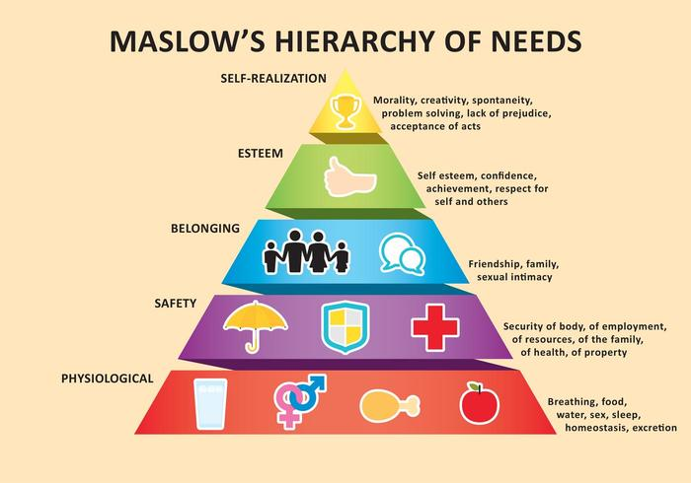

Slide 41
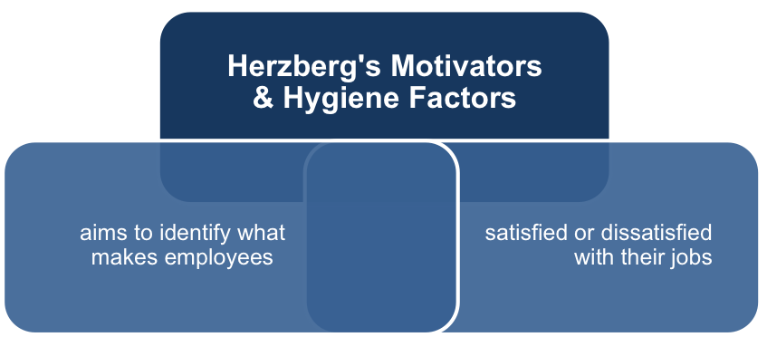

Slide 42
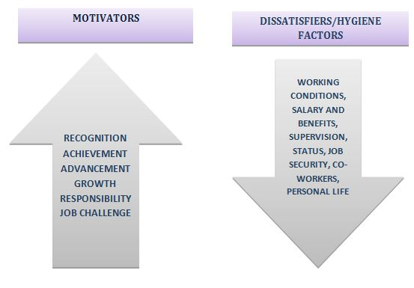
HERZBERG’S MOTIVATORS AND HYGIENE FACTORS
Read article on Herzberg's Motivators and Hygiene Factors

Slide 43
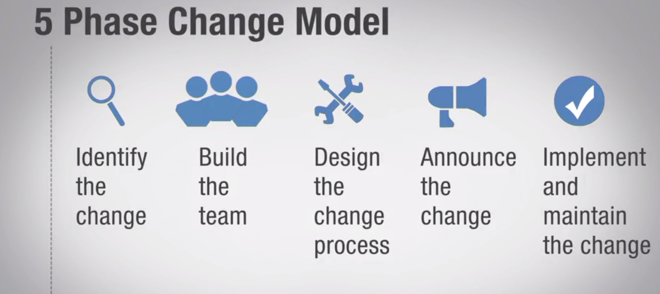
Watch video on 5 Phase Change Model

Slide 44
Learning and the Individual Learner
All personal change involves unlearning old ways of behaving and learning new ones
As a result it is helpful to have a way of looking at the learning process and how different people like to learn
Kolb described a cyclical process of adult learning and Honey and Mumford observed different learning styles (this was discussed at our LEAD module)
Effective change managers need to understand the connection between change and learning and would greatly benefit on good working knowledge of learning theory, skills development, training planning and coaching.
Change managers also need to understand how people react to change – why they embrace or resist it, the impact of motivations and of personality.
Reflect on learning about the different learning styles from the LEAD module

Slide 45
Honey and Mumford Learning Style Model
Reflect on learning about the different learning styles from the LEAD module (Day 1 face to face workshop)

Slide 46
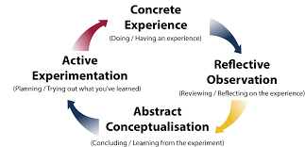
David Kolb Learning Cycle
ACTIVIST
PRAGMATIST
REFLECTOR
THEORIST

Slide 47
EXAMPLES OF PREFERENCES OF DIFFERENT LEARNERS
ACTIVIST | REFLECTORS
On-job learning trial and error Coaching from a respected practitioner Activity-based learning in groups Well-simulated work environments | Observing others “live” or on video Action learning sets Making notes and keeping learning diary Well-Stimulated work environments
PRAGMATISTS | THEORISTS
Practical workshops On-job learning by trial and error Applying tools and models to practice situations Well-simulated work environments | Courses and seminars Lecture and presentations Reading and personal research Well-simulated work environments

Slide 48
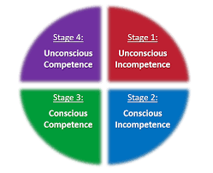
Learning New Skills: Conscious Competence Learning Model
I can do this quite easily now
I know not to do my current job
I am making progress as long as I take it slowly
I have to learn a new way of working and it is challenging

Slide 49
THANK YOU!

